Slide 1


Slide 2
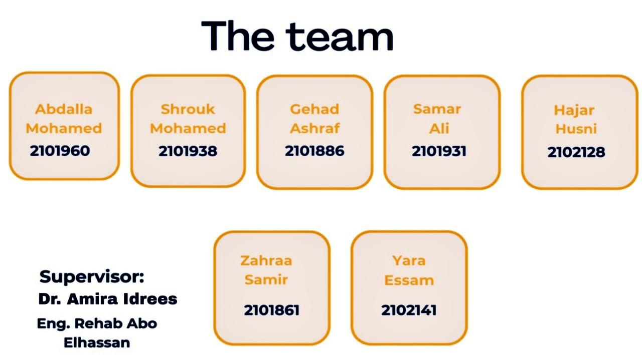

Slide 3
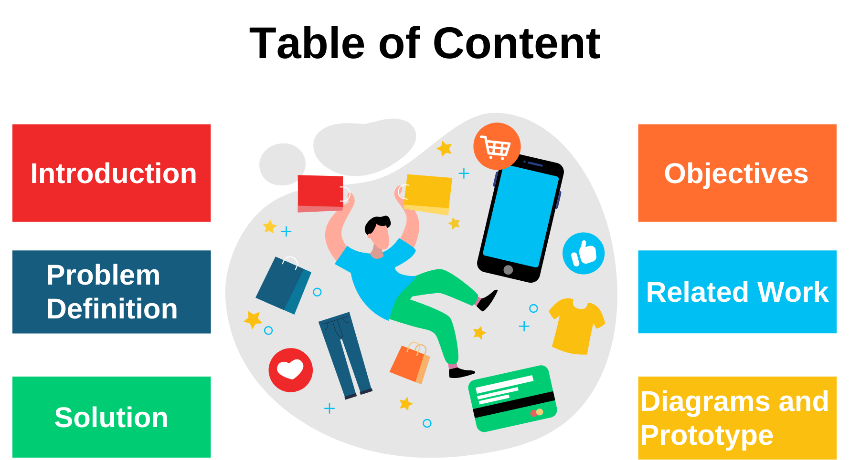

Slide 4
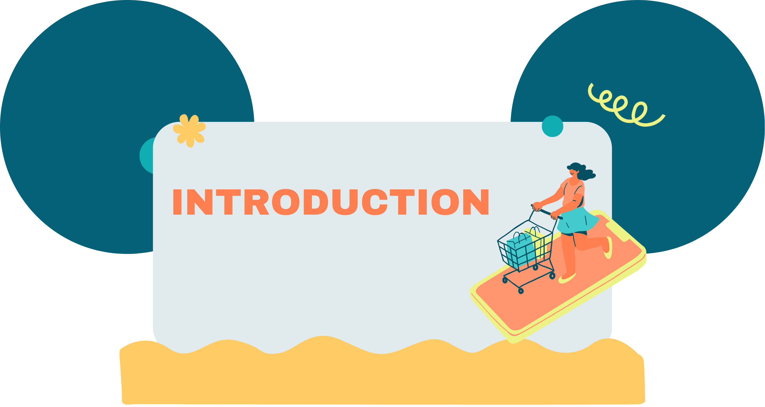


Slide 5
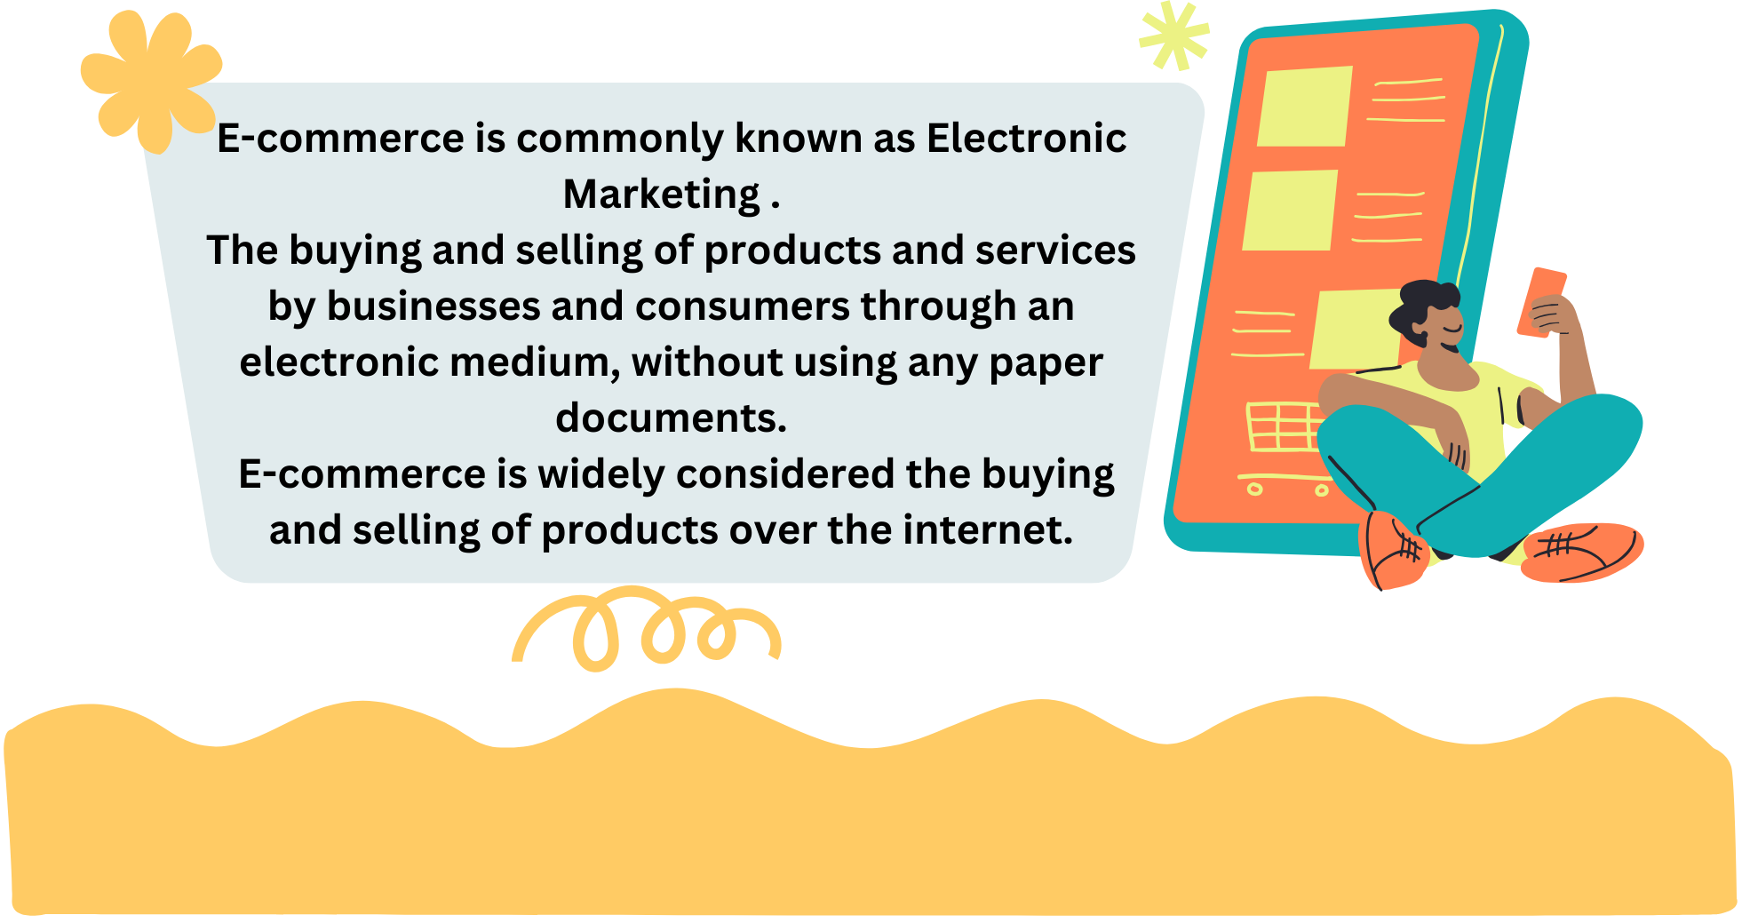

Slide 6
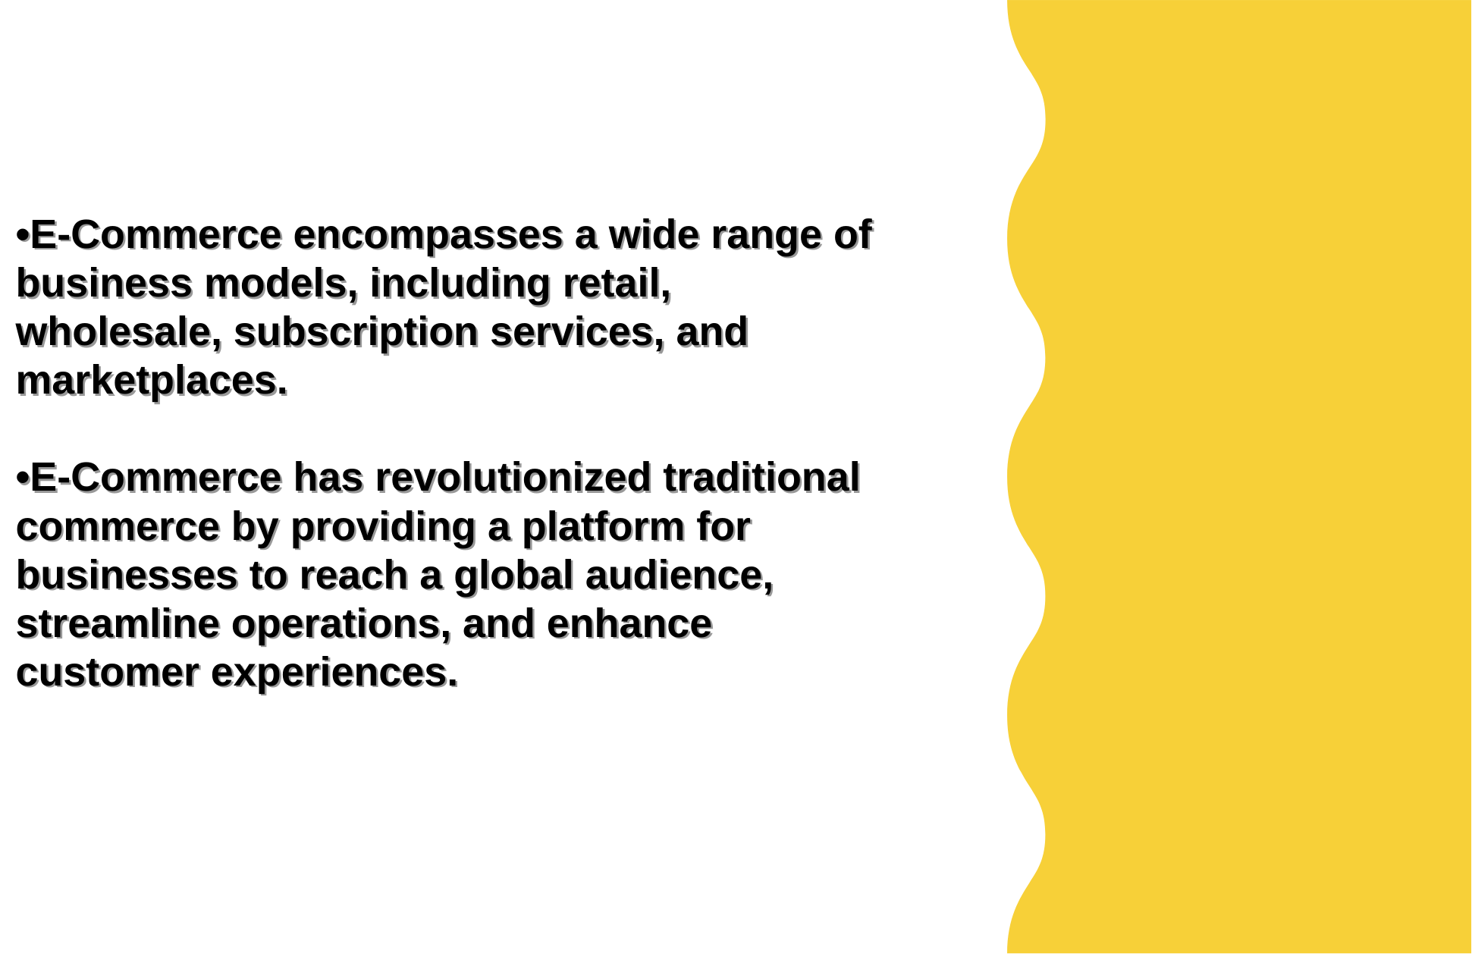
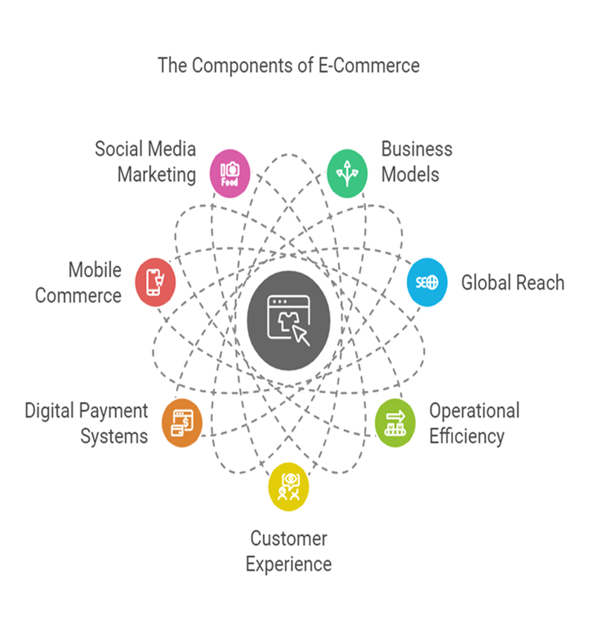

Slide 7
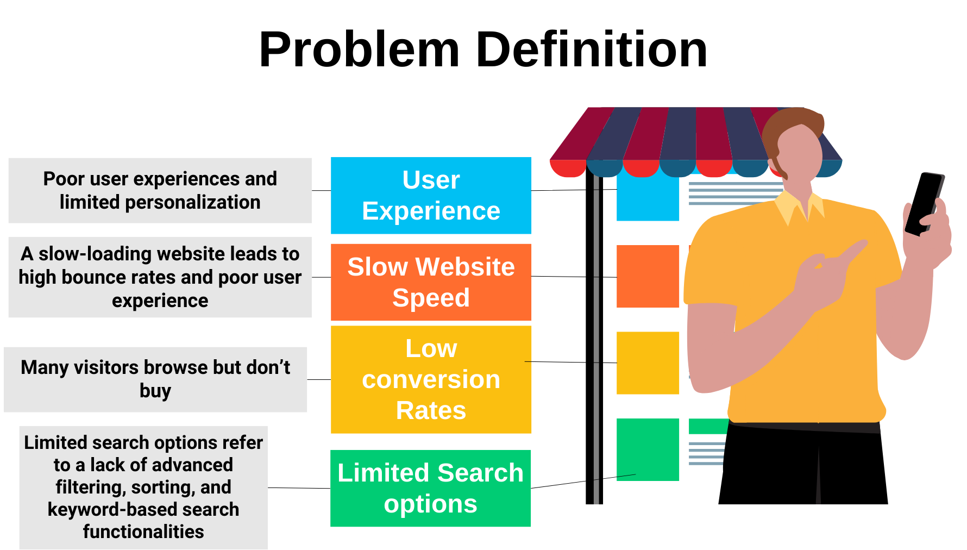

Slide 8
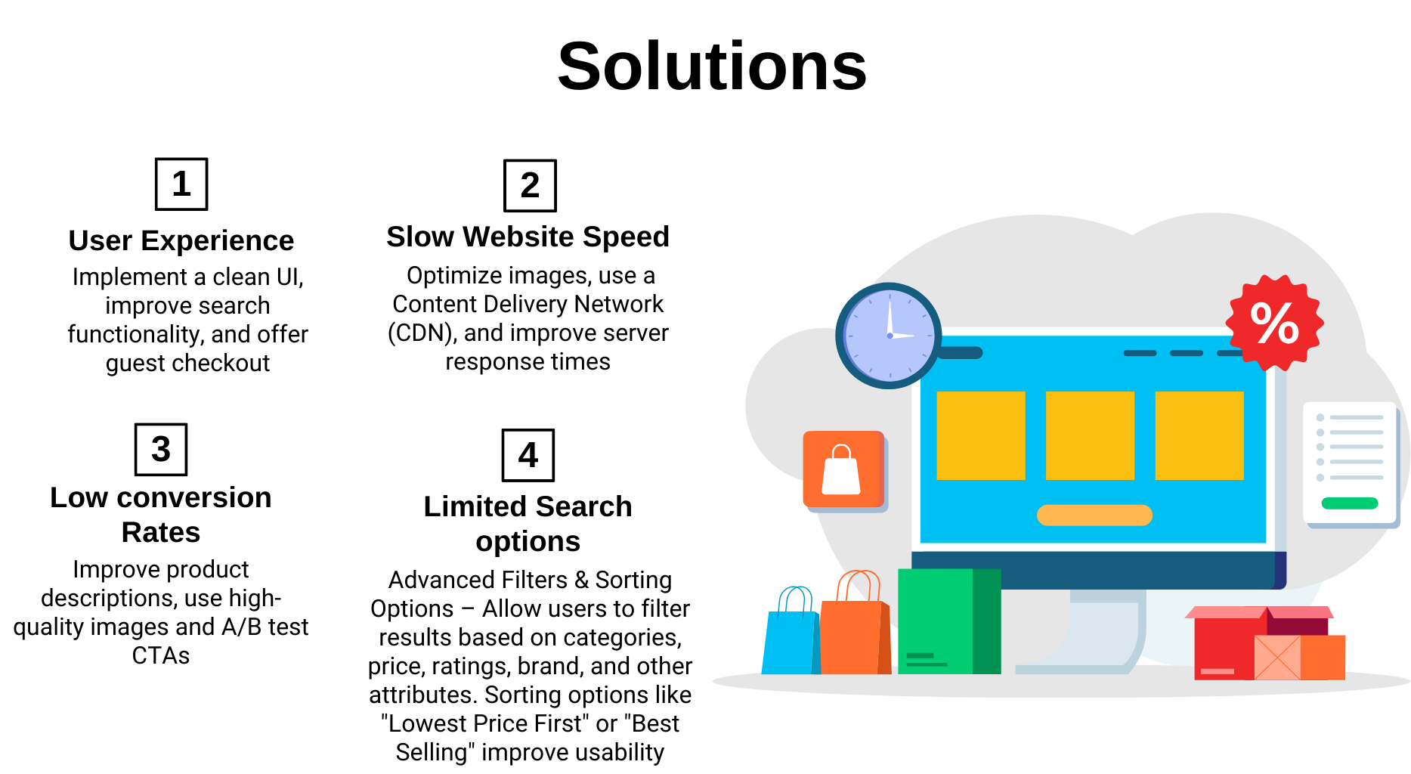

Slide 9
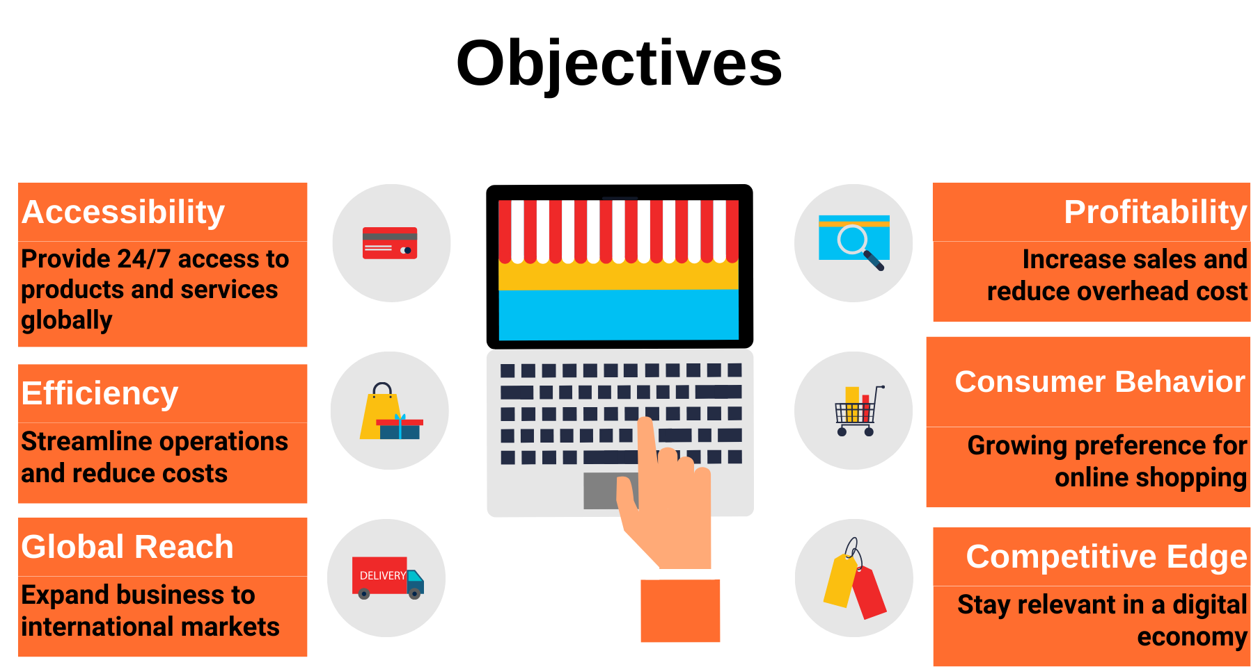

Slide 10
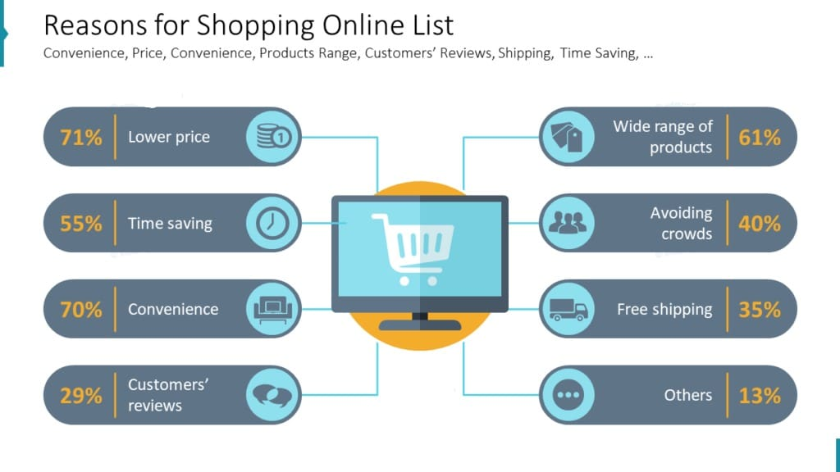

Slide 11
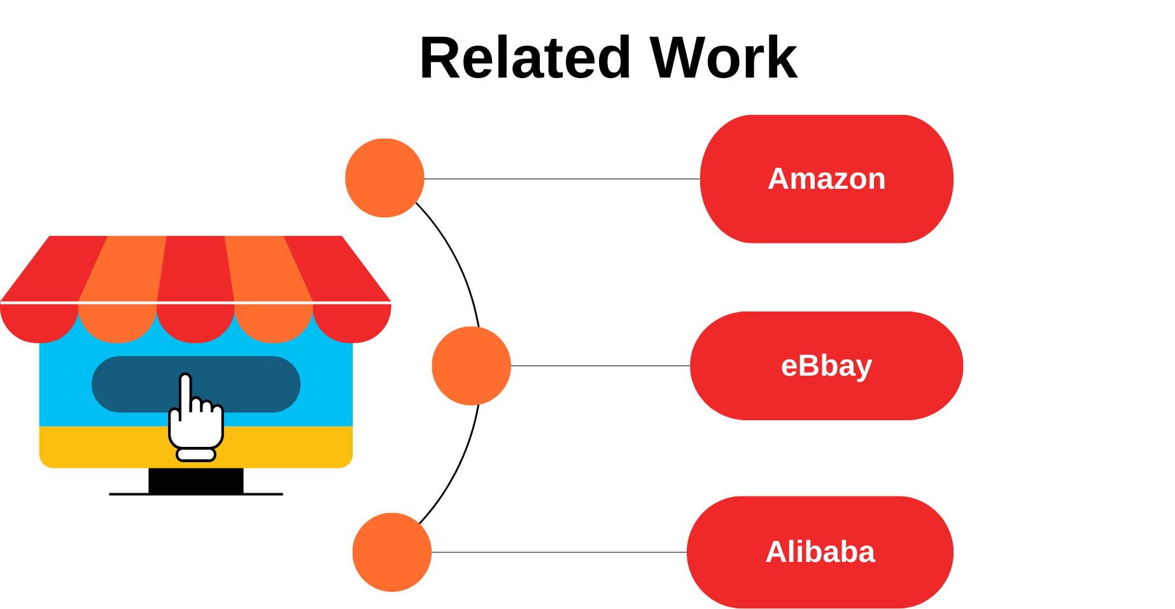

Slide 12
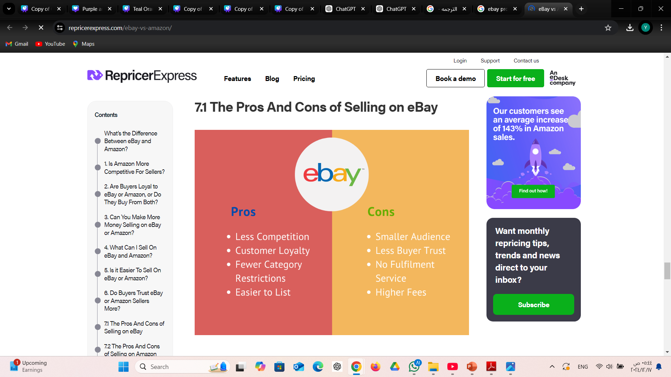
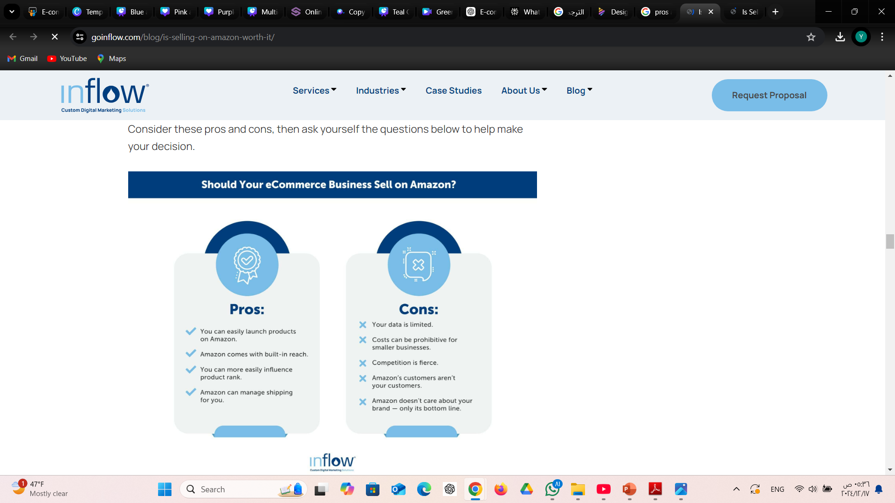
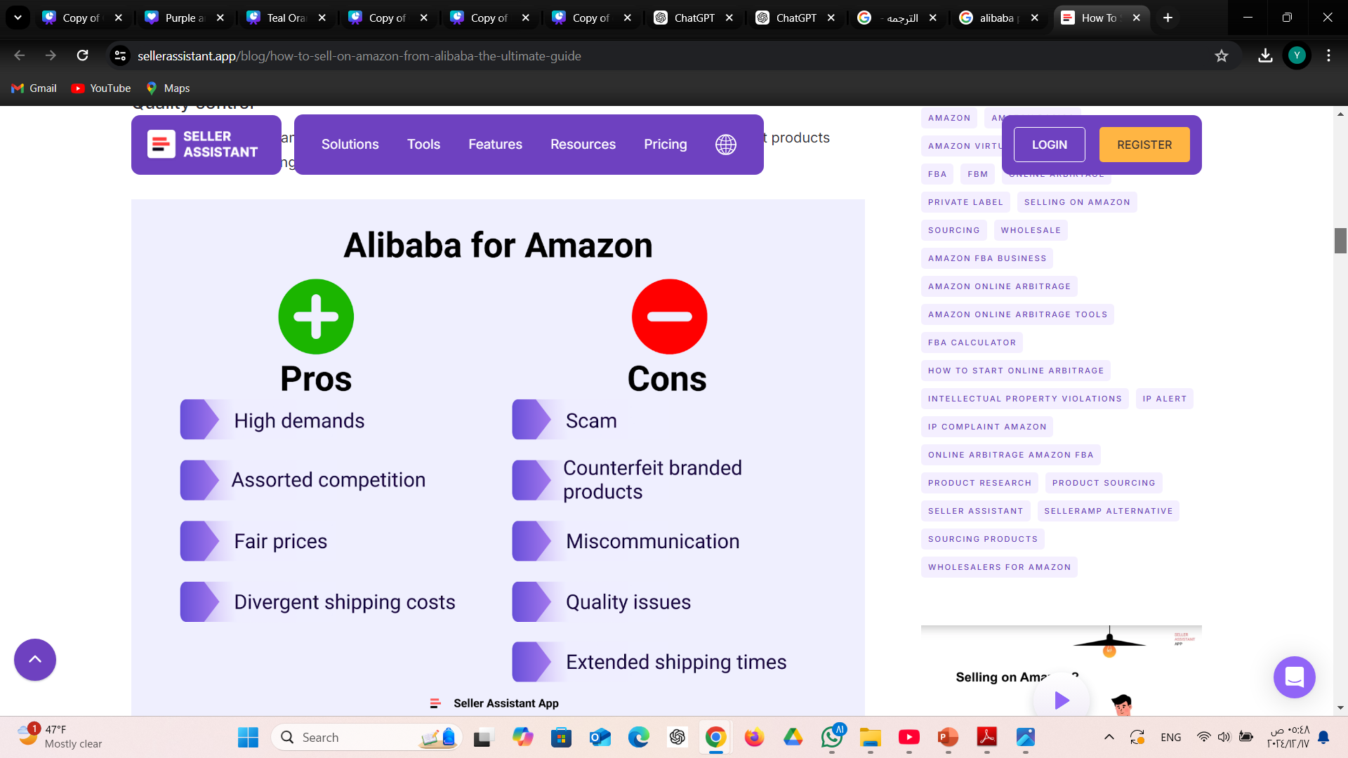

Slide 13
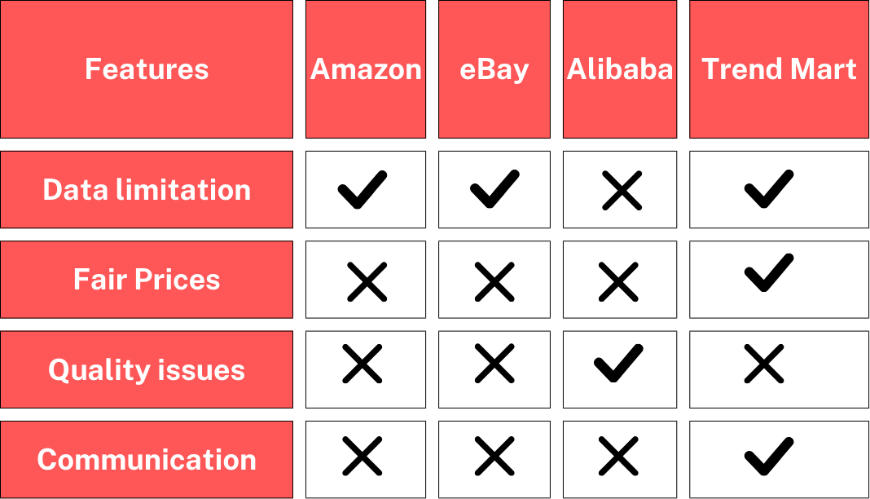

Slide 14


Slide 15
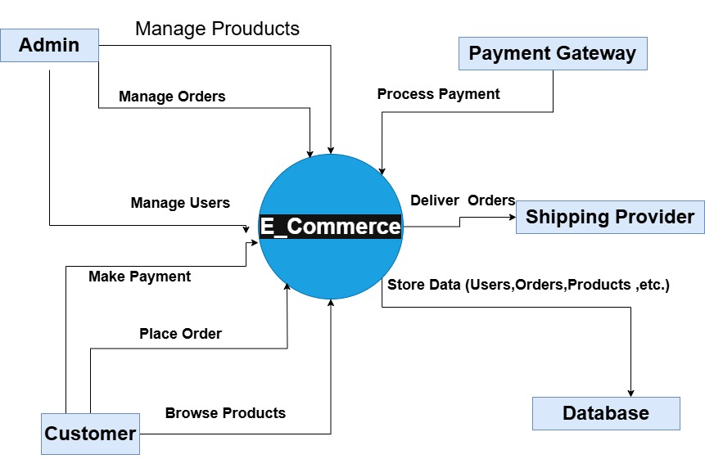
Context Diagram

Slide 16
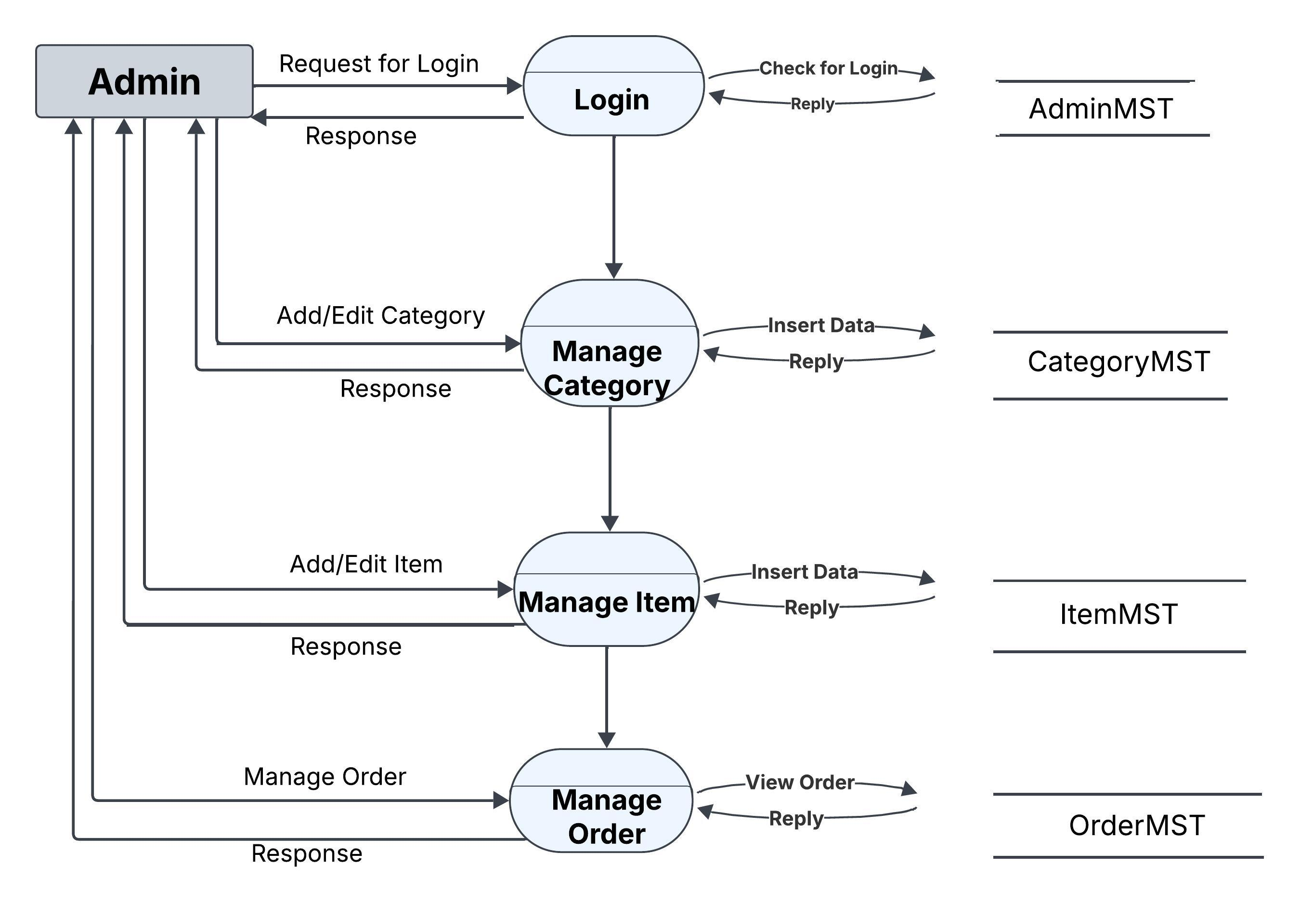
Data Flow Diagram

Slide 17
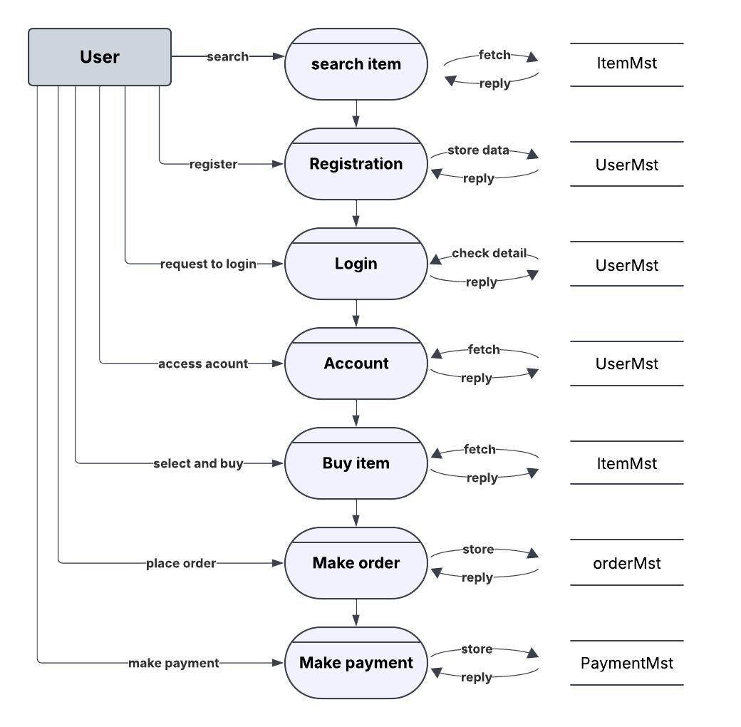
Data Flow Diagram

Slide 18
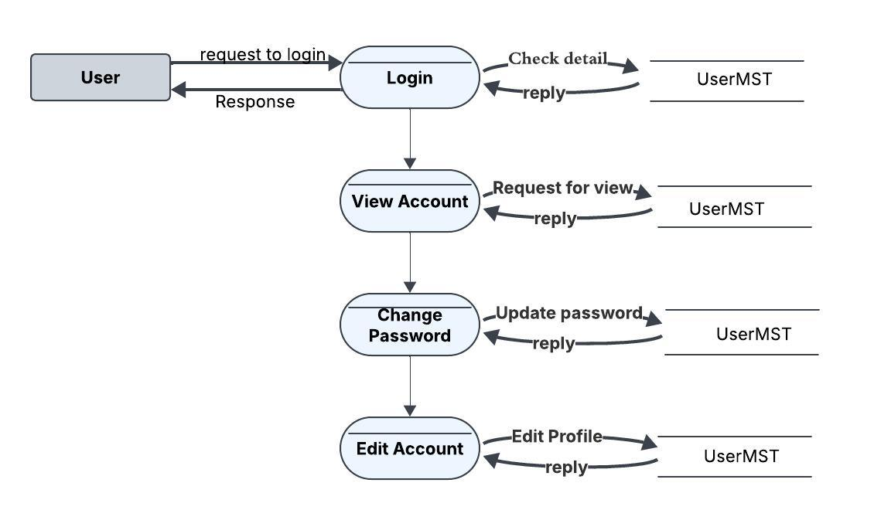
Data Flow Diagram

Slide 19
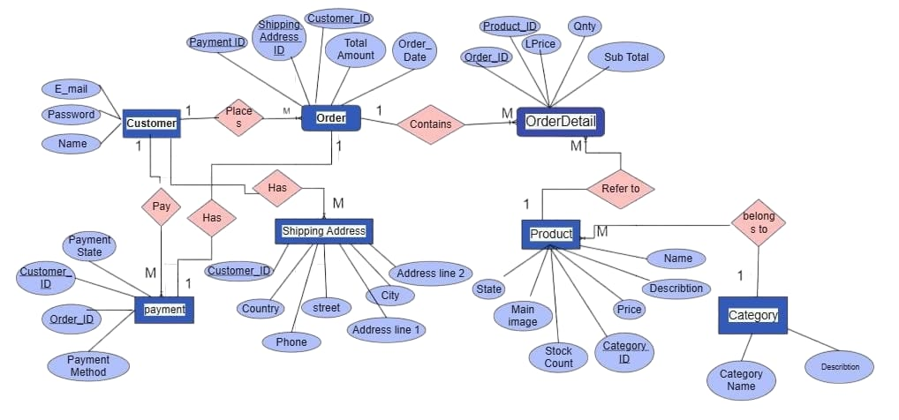
Entity Relationship Diagram

Slide 20
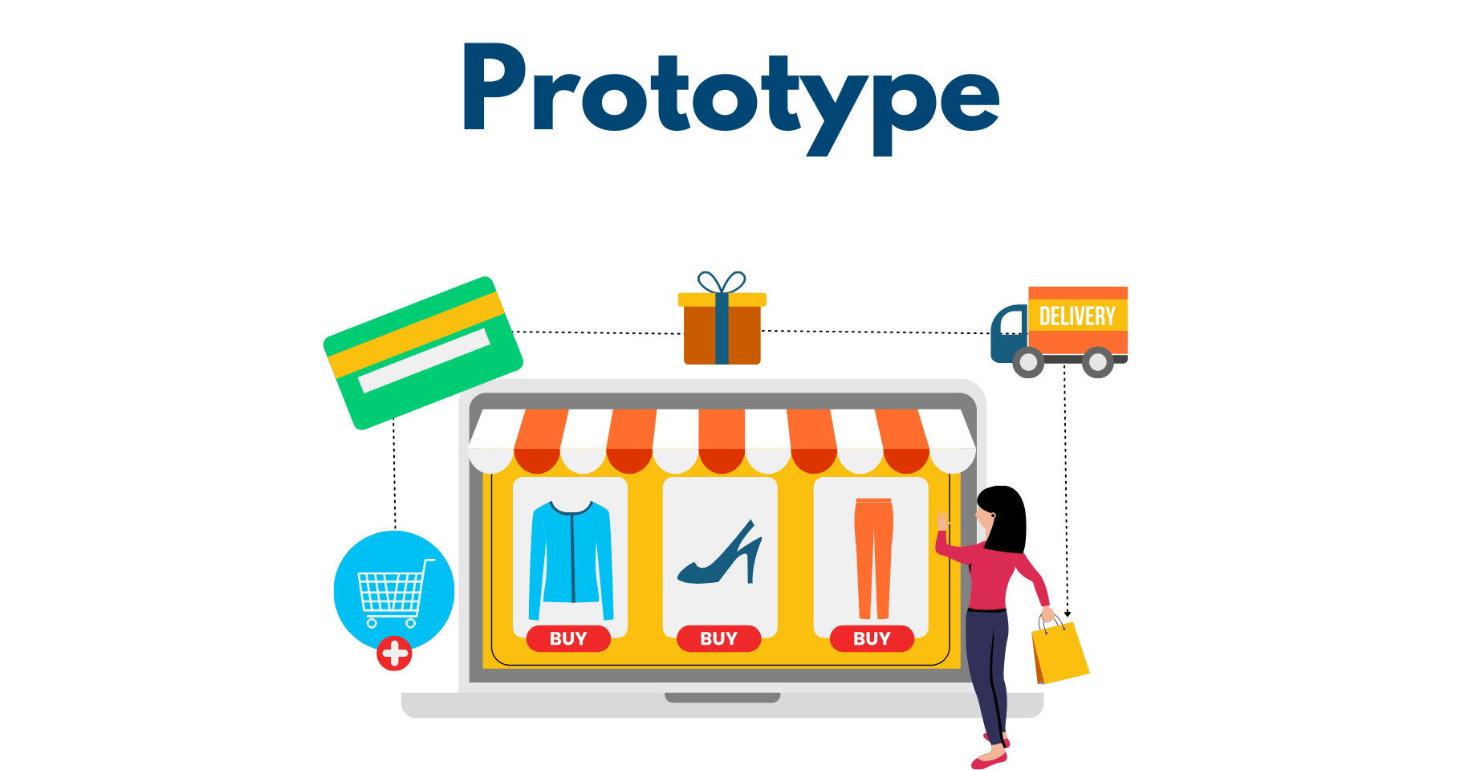

Slide 21
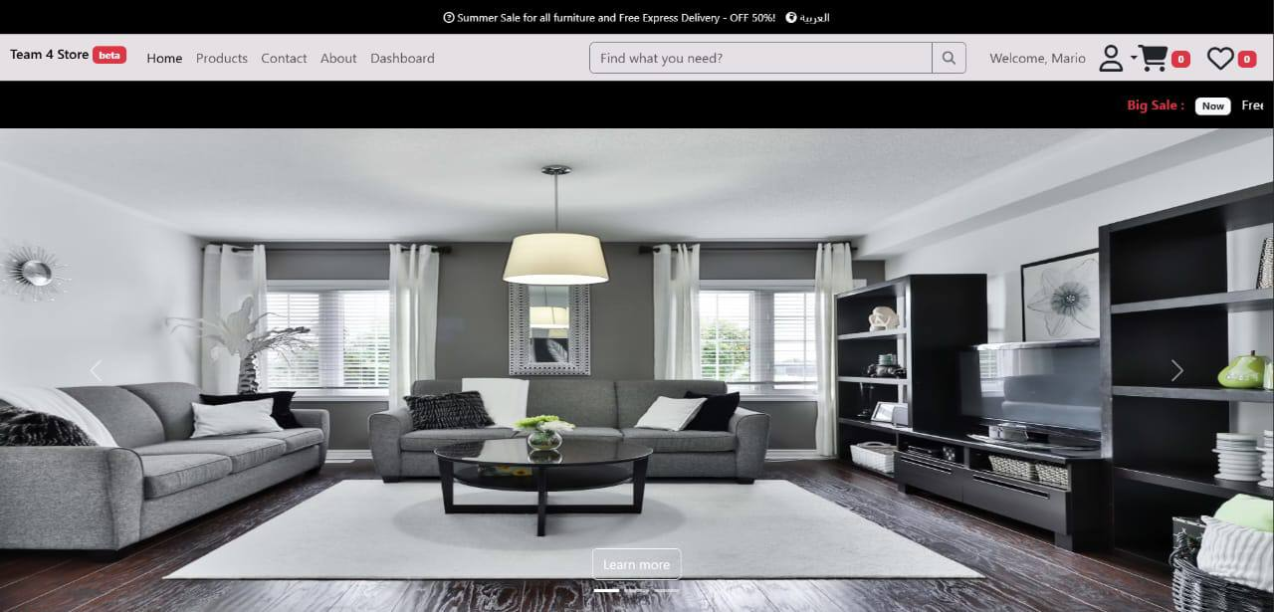
After the user logs into the website, they can navigate to the Home Page, where they can
• Browse: Click “Products”
• Search: Use search bar
• Details: “Learn More” on banner
• Account: User icon = login/register
• Add to Cart: Click button
• Wishlist: Heart icon
• Checkout: Cart

Slide 22
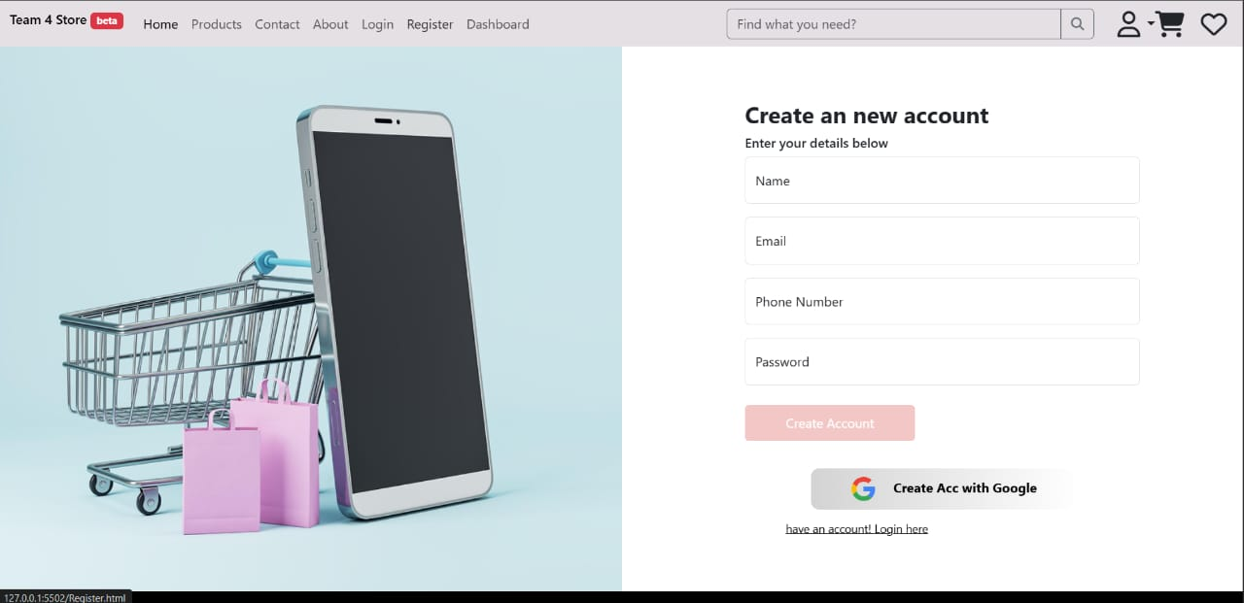
Register Page 🔹 You can access it: from the top menu, click “Register”
and then ,
Enter your Name, Email, Phone, Password
Click “Create Account”
Or sign up with Google
If you already have a previous account, you
will log in using the password and email

Slide 23
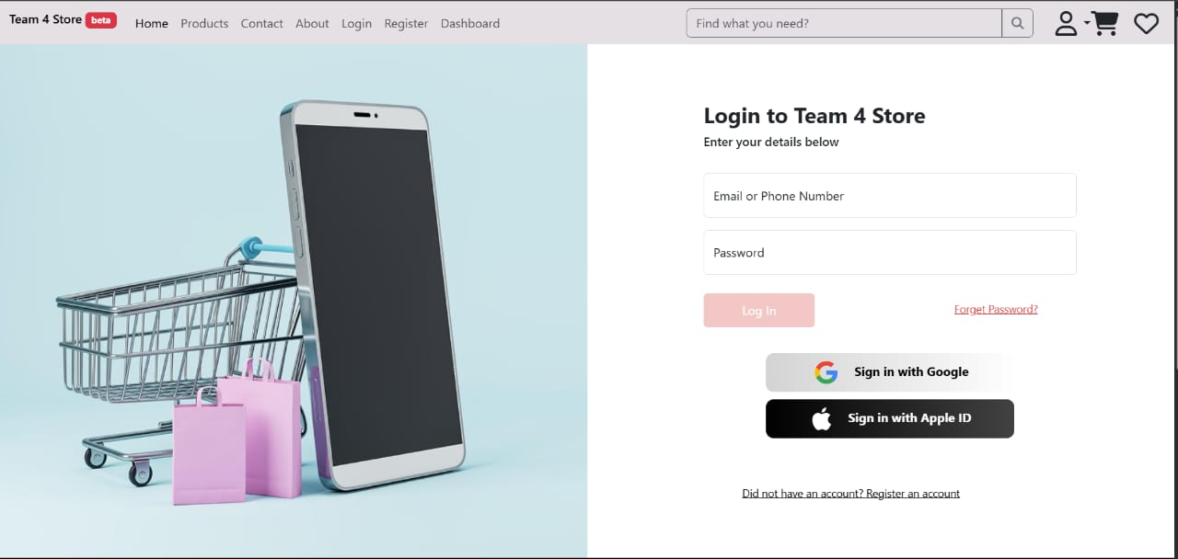
Login Page
🔹 You can access it:
From the top menu, click “Login”
and then ,
Enter your Email or Phone Number and Password
Click “Log In”
Or log in using Google or Apple ID
If you forgot your password, click “Forget Password?”
If you don’t have an account, click “Register an account”

Slide 24
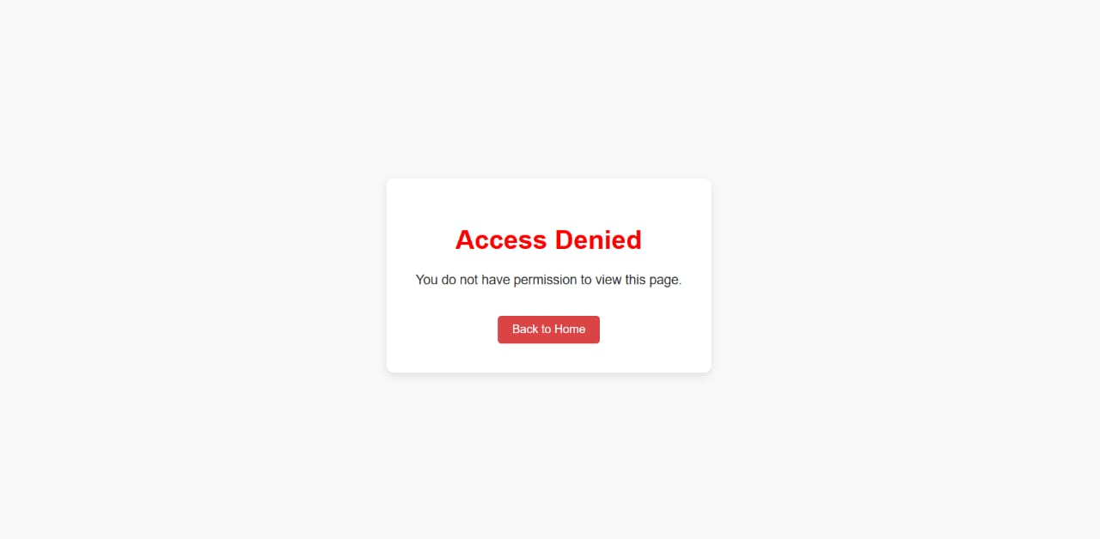
This page appears when a user tries to open something they are not allowed to see. For example, if someone without permission tries to access an admin page, the system will show this "Access Denied" message. This helps protect important information and makes sure only the right people can see or change certain things.

Slide 25
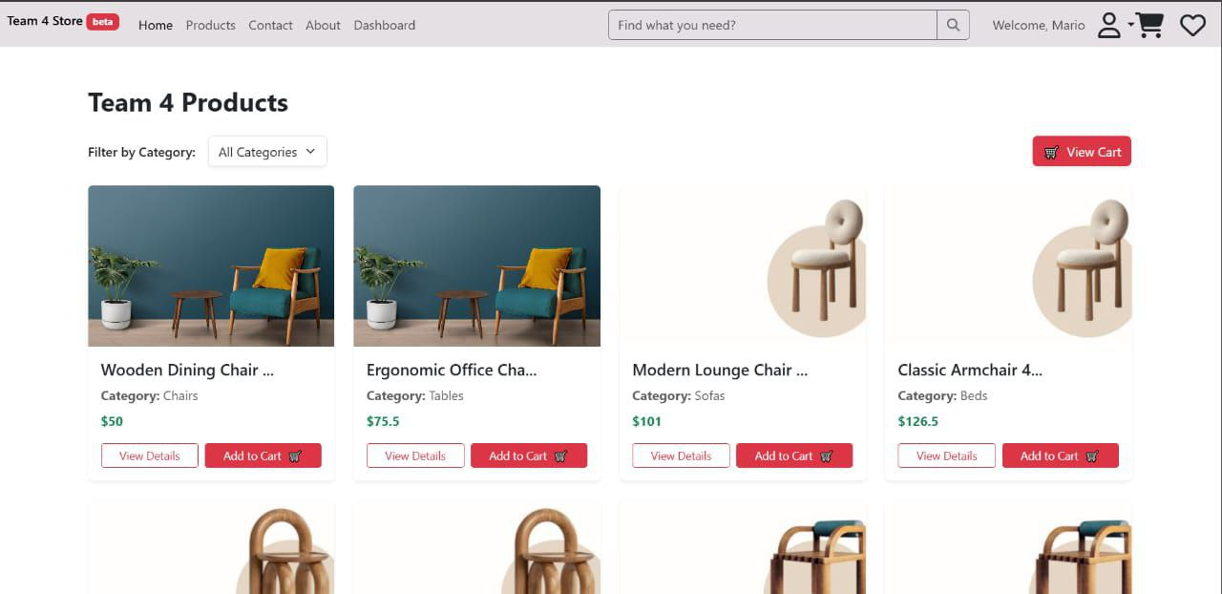
This Page allow us to:
Help the user browse all products
Let the user filter by category
Allow the user to view details or add to cart
Navigate to the cart and prepare for checkout

Slide 26
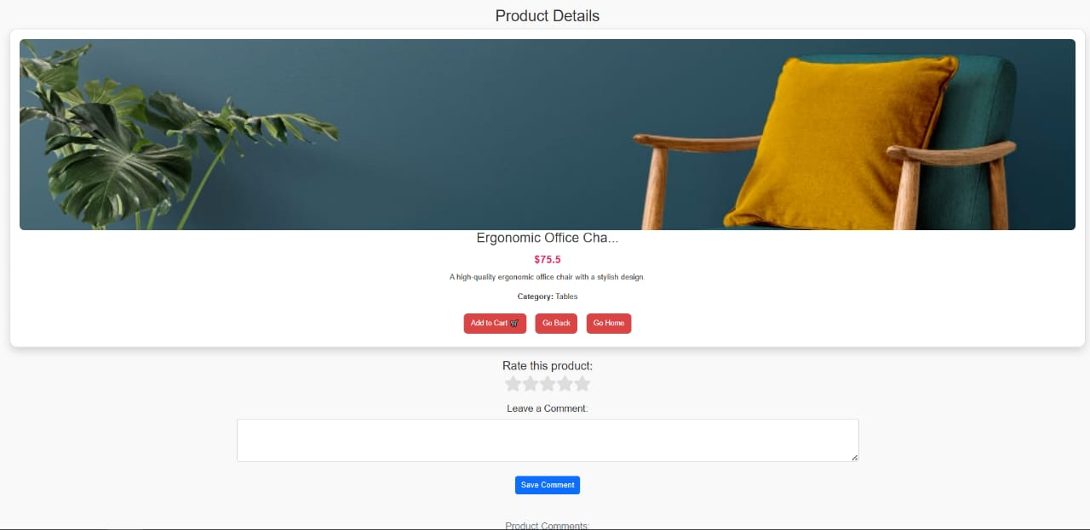
Product Details Page
🔹 To access it:
Go to Home Page
Click on any product you want to view
🔹 What to do on this page:
Check product image, name, and price
Read the description and category
Click “Add to Cart” if you want to buy it
Rate the product and leave a comment
Use Go Back or Go Home buttons for navigation

Slide 27
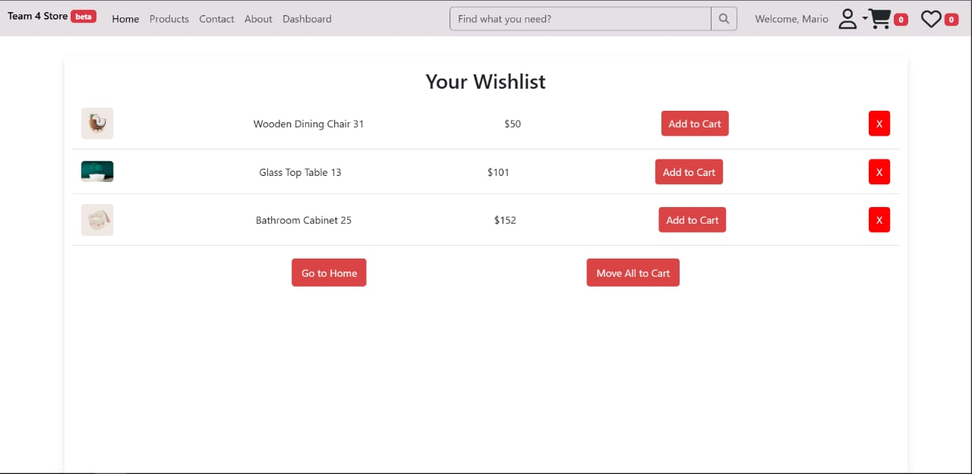
User logs in and clicks the heart icon to open the Wishlist.
The page shows all saved products (image, name, price).
User can:
- Add items to cart
- Remove items
- Move all to cart
- Go back to homepage
Helps users manage products they plan to buy later.

Slide 28
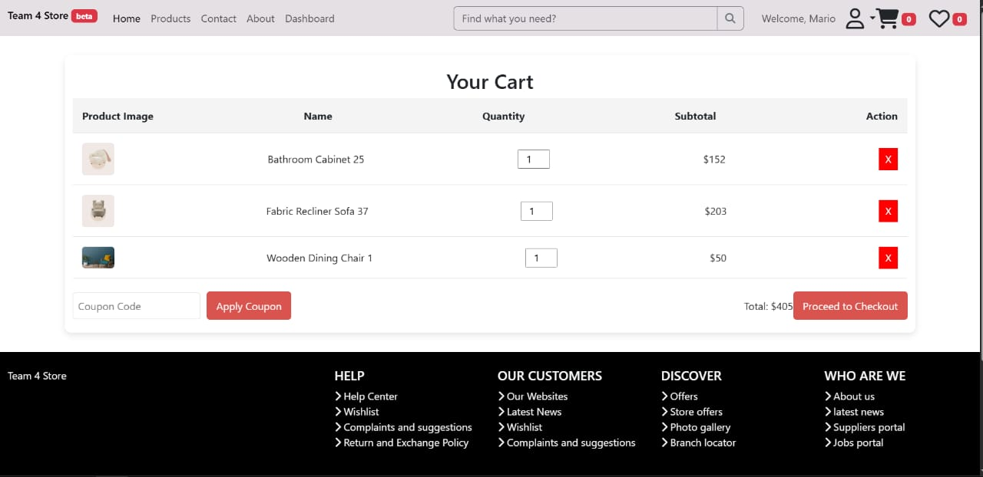
After adding products, I click the cart icon to open this page.
Here, I see all my selected items with image, name, quantity, and price.
I can change quantity or remove items with the red X.
I can enter a coupon code to get a discount.
The total price is shown at the bottom.
Then I click "Proceed to Checkout" to finish my order

Slide 29
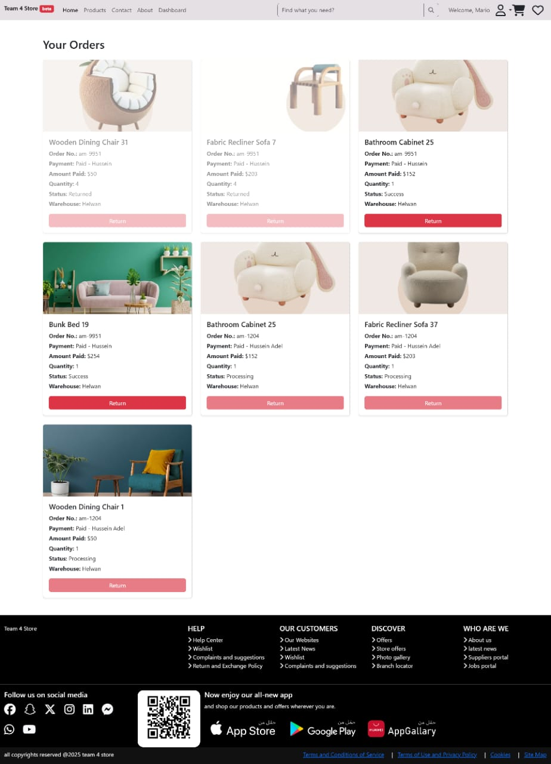
This page shows all the products the user has ordered. Each box shows details like the product name, image, order number, payment info, quantity, order status (like returned, success, or processing), and warehouse location.
The user can also click the Return button if they want to return an item.
Basically, this page helps the user track their orders, check statuses, and manage returns in a simple and clear way

Slide 30
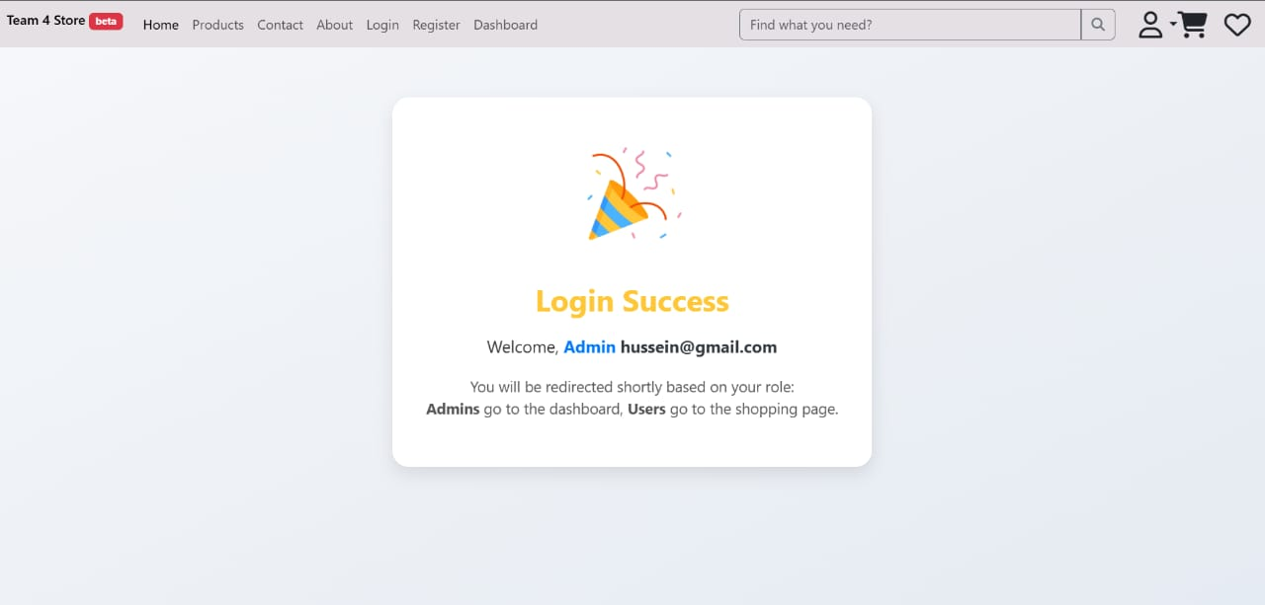
After the user logs in successfully, this page appears to confirm the login.
It shows a welcome message with the user's email and role.
Based on the role:
-Admins are redirected to the Dashboard.
-Users are redirected to the Shopping Page.
This redirection happens automatically after a few seconds, without needing any user action.
The page improves user experience by clearly showing what’s happening and where the user is going next.

Slide 31
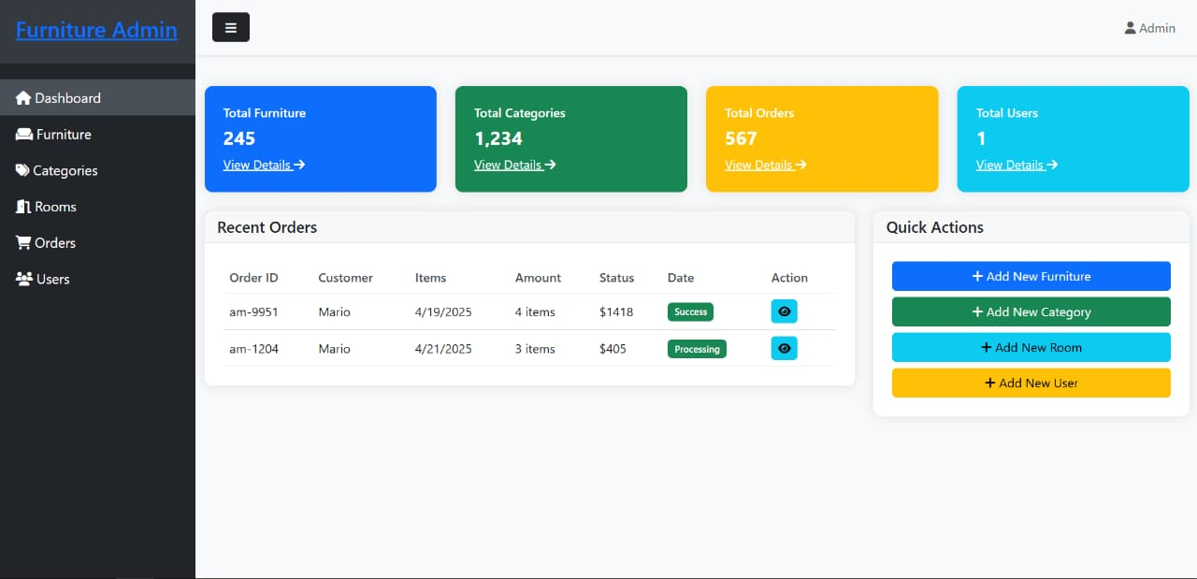
After the admin logs in, this page opens. It’s the main control panel of the system.
The admin can:
✅ See quick stats: furniture, categories, orders, users
✅ View recent orders and their details
✅ Add new furniture, category, room, or user
✅ Navigate to all other pages from the side menu
This page helps the admin manage everything easily in one place.

Slide 32
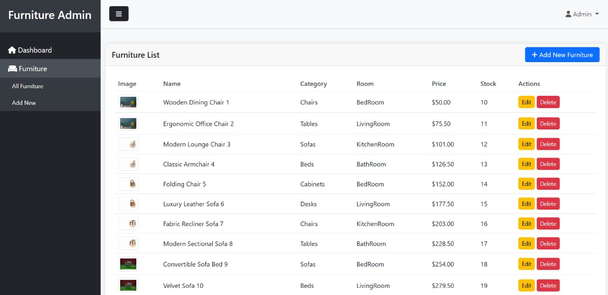
After the admin logs in and clicks on “All Furniture”, they arrive at this page.
Here, the admin can:
See all furniture items with details (image, name, category, room, price, stock)
Edit any item using the Edit button
Delete an item with the Delete button
Add new furniture using the Add New Furniture button at the top
This page is where the admin manages all the furniture in the system — viewing, updating, deleting, and adding items easily

Slide 33
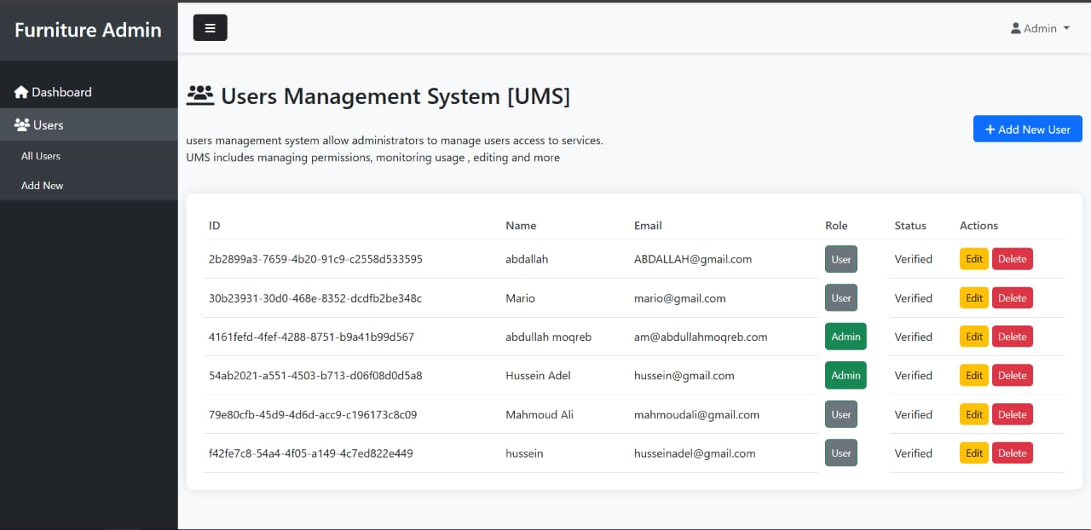
After I log in as an Admin, I go to "Users" then click on "All Users".
This page shows me a table with all users in the system.
For each user, I can see their ID, name, email, role (Admin or User), and status.
I can click "Edit" to change their info or role, or click "Delete" to remove them.
There’s also a button called "Add New User" to create a new user account.
-It lets the Admin control who is in the system,
what their permissions are, and helps keep everything organized and secure

Slide 34
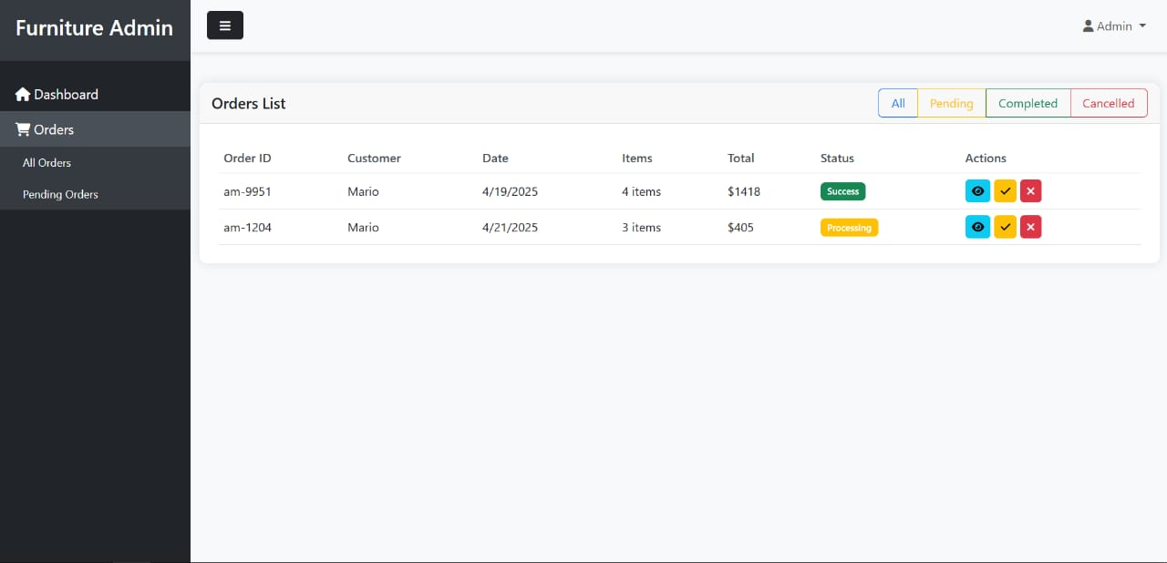
After logging into the admin dashboard, I go to Orders → All Orders from the sidebar.
I see a table showing all customer orders with details like:
Order ID, customer name, date, items, total, and status.
Each order has action buttons:
👁 View details
✅ Mark as completed
❌ Cancel the order
I can also filter orders by status: All, Pending, Completed, or Cancelled.
This page helps the admin manage and update orders easily.

Slide 35
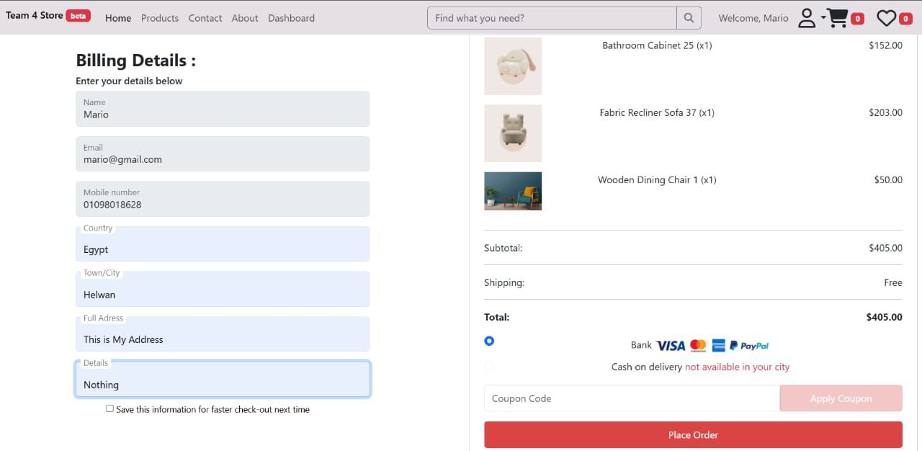
This page is where the user completes their purchase.
On the left, the user enters their personal and billing details: name, email, phone, country, city, address, and any notes.
On the right, they see a summary of the products they’re buying, the total cost ($405), and free shipping.
The system shows that cash on delivery is not available in their city, so they must pay online using Visa, MasterCard, or PayPal.
They can also enter a coupon code if they have one.
Finally, they click “Place Order” to confirm and finish the purchase.
This page makes the checkout process quick, clear, and secure

Slide 36
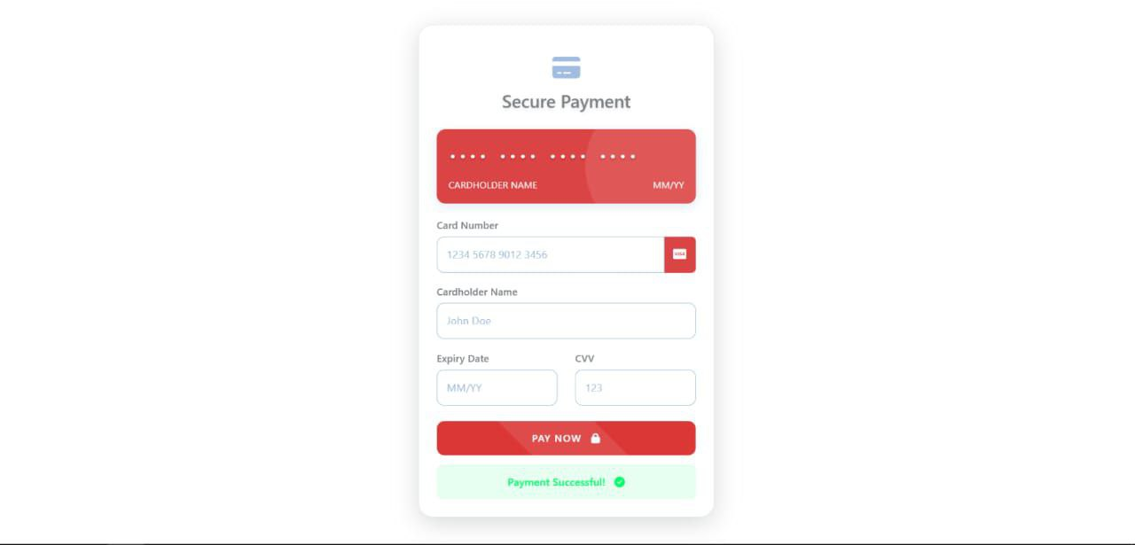
This page is where the user enters their credit card information to pay online. They fill in details like the card number, name, expiry date, and security code (CVV). After clicking "Pay Now," the system processes the payment. If everything is correct, a message appears confirming that the payment was successful. This page helps users pay safely and easily through the website

Slide 37
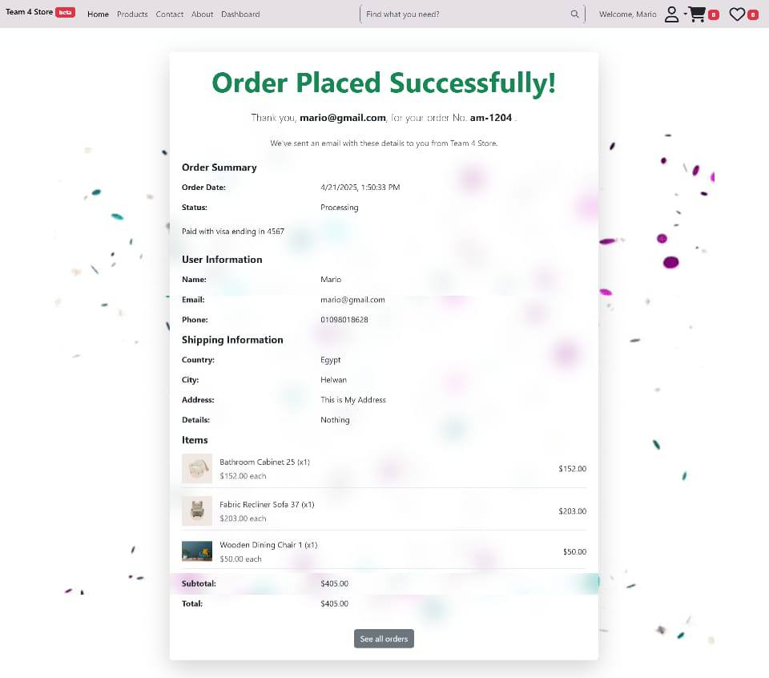
After the user confirms the order, they are taken to the order confirmation page, where they can review the order details, verify their personal information, check the shipping address, confirm their email, and view all their past orders

Slide 38
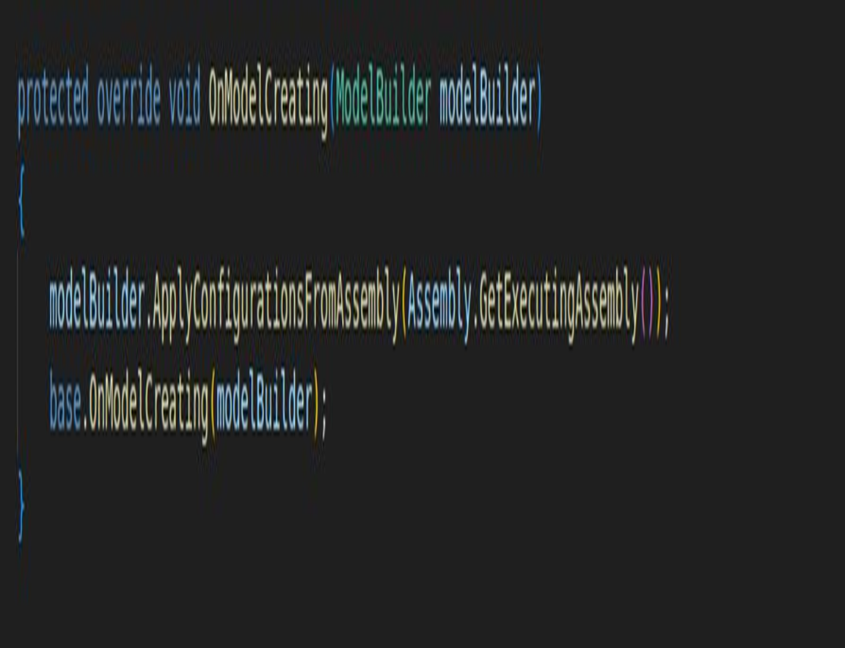
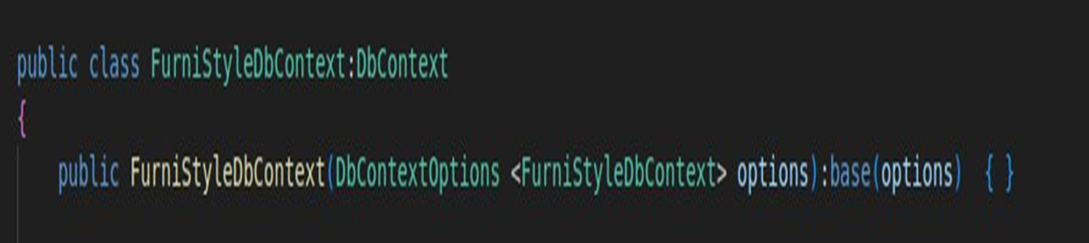
It auto-loads all table settings from the project when building the database model.
It sets up the database connection for the context

Slide 39
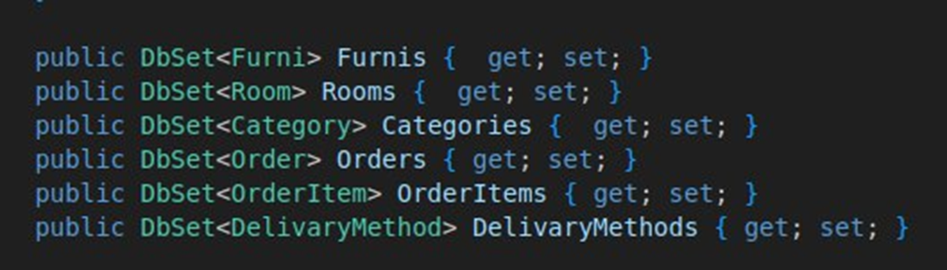
They represent database tables for Furni and Order.

Slide 40


